Slide 1
SCOPE: Spatio-Temporal Collaborative Caching and Proactive Transfer in LEO Satellite Networks
Yuyu Liu, Qian Wu, Zeqi Lai, Hewu Li, Yuanjie Li, Jun Liu
Tsinghua University
APNet 2026
Notes:
Good afternoon everyone. I am very glad to present our work, SCOPE — a Spatio-Temporal Collaborative Caching and Proactive Transfer framework for Low Earth Orbit satellite networks. The core idea of this work is to rethink satellite content caching jointly in two dimensions: spatially, we organize satellites into latency-bounded collaboration groups so that their isolated storage can be pooled; and temporally, we proactively migrate high-value content from leaving satellites to entering ones during the handover window, so users never feel the cold-start. I will walk you through the motivation, the design, and the evaluation.

Slide 2
Outline
01
Background & Motivation
Why isolated satellite caching breaks under high mobility
02
Design of SCOPE
Spatial grouping + Temporal proactive transfer
03
Performance Evaluation
Robustness, service continuity, cost-efficiency
04
Conclusion & Related Work
Key takeaways and future directions
Notes:
This presentation is organized into four parts. First, I will introduce the background and motivation, especially why isolated caching breaks down under the high mobility of LEO satellites. Then I will present the design of SCOPE, including its spatial collaboration and its temporal proactive transfer mechanism. After that, I will show our evaluation results from three perspectives: robustness, service continuity, and cost-efficiency. Finally, I will conclude the talk and discuss related work.

Slide 3
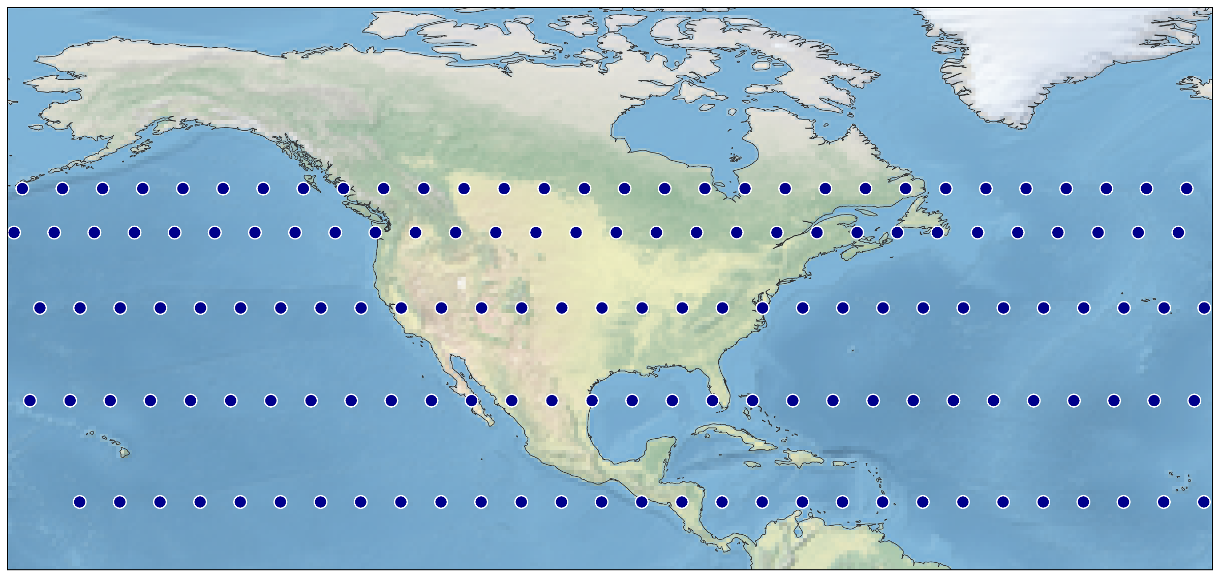
Part 1 / Background & Motivation
Tsinghua Univ.
Why isolated caching falls short
Motivation chain
01
01 LEO enables SEC
Lower latency + growing onboard storage make satellites viable edge caching nodes.
02
02 Mobility breaks cache locality
Coverage shifts every ~3–4 minutes; each handover can bring a cold cache.
03
03 Isolated caches become islands
Independent caching cannot reuse region-relevant objects across changing members.
Fig. 1: Starlink Phase I snapshot — dense mesh over North America
04
04 Resource pooling is feasible
Dense Starlink mesh provides many ISL-connected neighbors for collaboration.
Key implication
Spatial collaboration is physically possible; the remaining challenge is to coordinate who stores what and when to transfer it.
Take-away: LEO enables in-orbit caching, but mobility creates cache islands; SCOPE responds with spatial resource pooling and proactive transfer.
Notes:
This merged motivation slide combines the original background, LEO edge caching, cache-island problem, and spatial-feasibility observation. I first introduce why LEO constellations are a promising substrate for Satellite Edge Caching: compared with GEO systems, LEO offers lower latency and higher throughput, and modern satellites increasingly have onboard storage and computation. Then I explain the core problem. Because LEO coverage shifts every three to four minutes, terrestrial CDN strategies cannot be directly reused; every handover may replace a warm, region-relevant cache with a cold or irrelevant one, creating the cache-island effect. Finally, I point to the Starlink snapshot on the right: the constellation is dense enough that many neighboring satellites are connected through ISLs, so resource pooling is physically feasible. This leads directly to SCOPE: we need spatial collaboration among nearby satellites and proactive transfer before handover, instead of treating each satellite as an isolated cache.

Slide 4
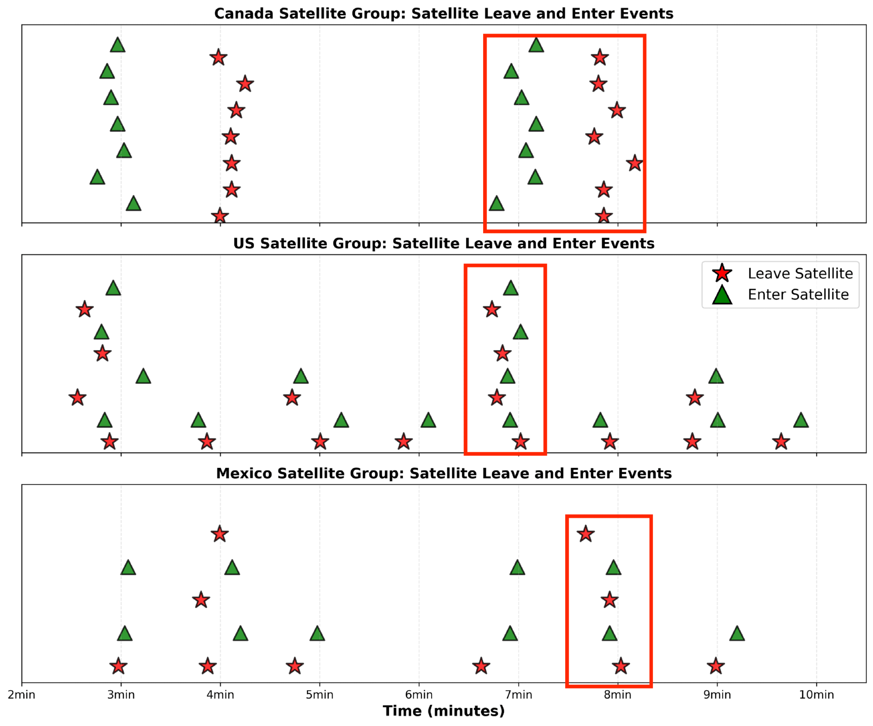
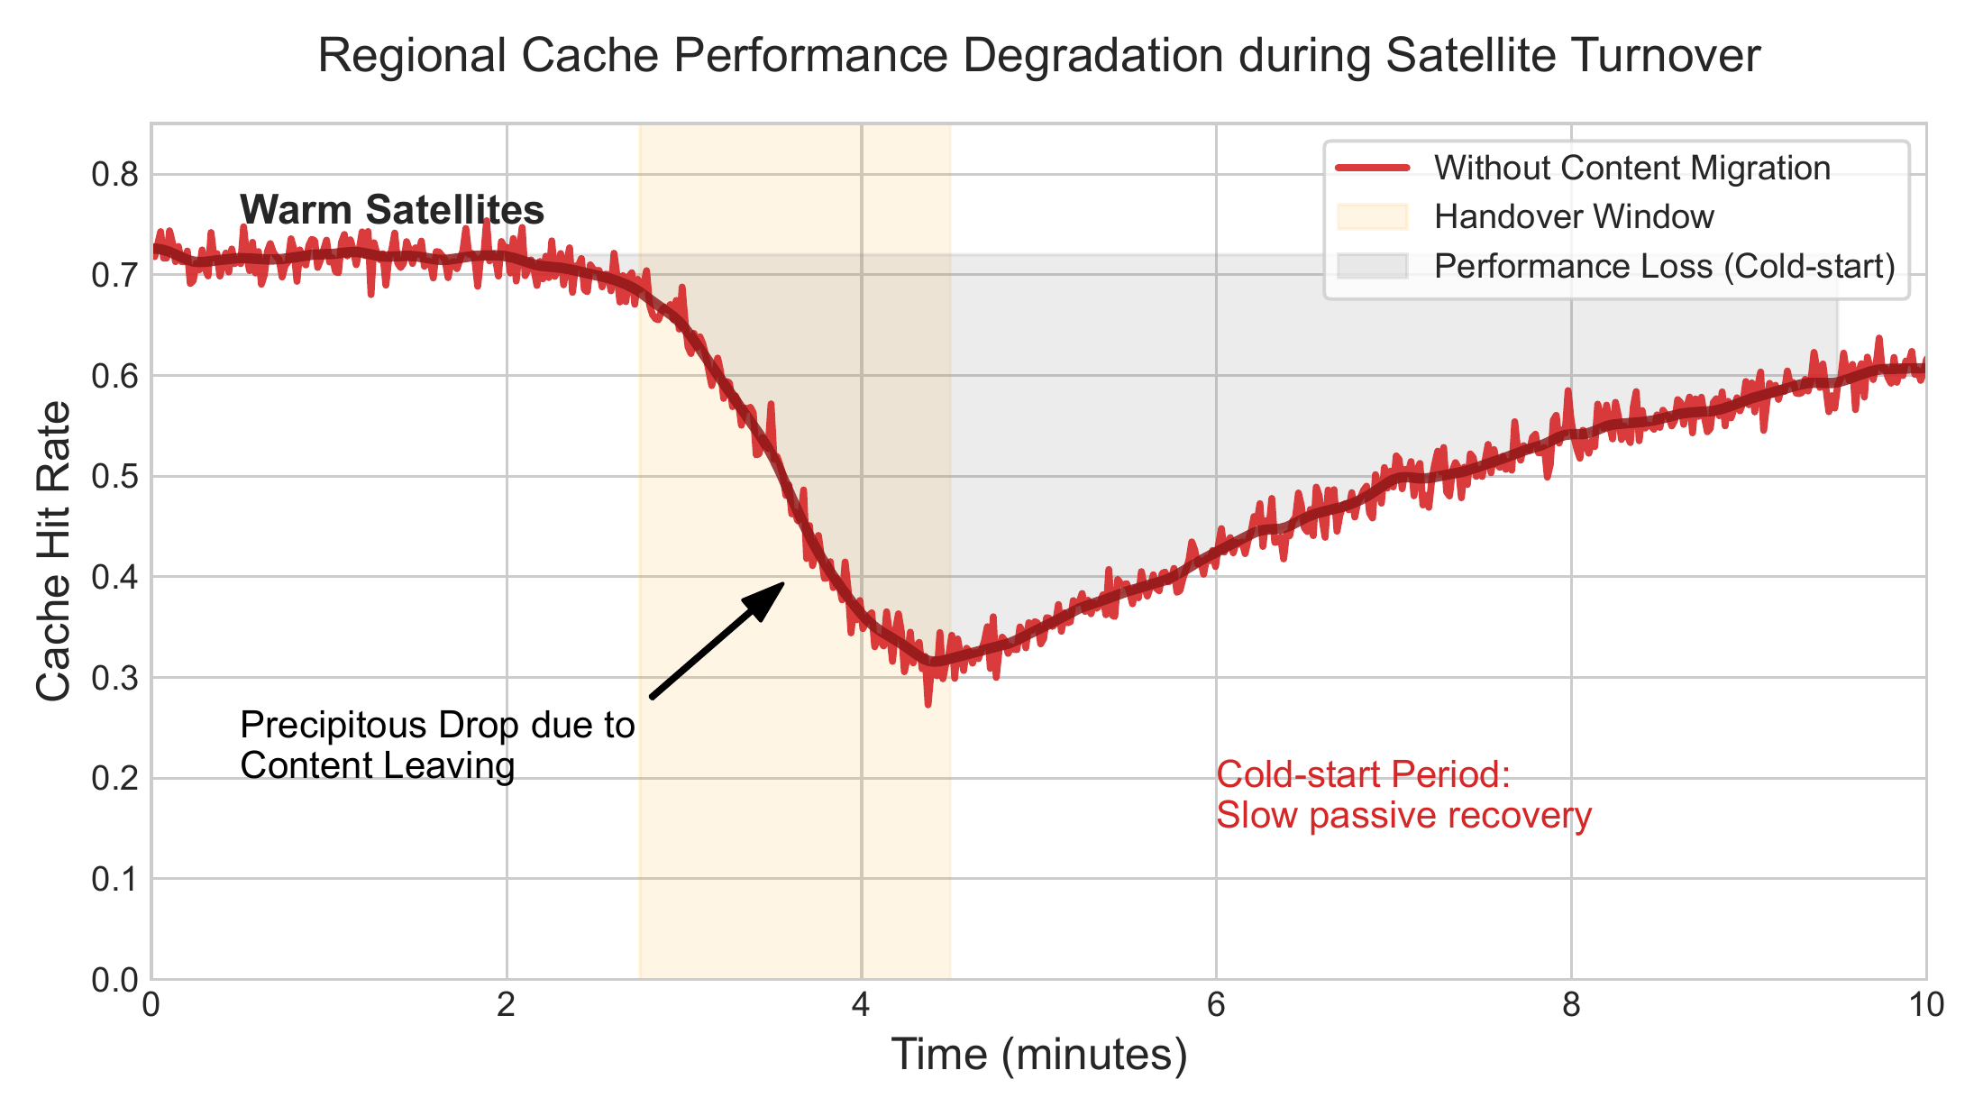
Observation 2 — High Dynamics & Performance Dip
Fig. 3: Satellite Enter/Leave events
Fig. 4: Regional cache hit rate during turnover
Dynamic Turnover
Performance Dip
Cold-Start
Handover Window
Warm sats leave;
cold sats enter every minute
Hit rate drops
72% → 30%
Entering sats need
long passive recovery
~30s overlap →
time to migrate
Notes:
Our second observation is about high temporal dynamics. We analyzed the Starlink Shell-1 trace and recorded satellite Enter and Leave events for different ground regions. As you can see in Figure 3, between t equals six minutes and t equals seven minutes, a batch of warm satellites leaves the US group while a new batch of cold satellites enters. Figure 4 quantifies the impact: the regional cache hit rate suffers a precipitous decline, from seventy-two percent down to thirty percent, exactly as those region-relevant satellites depart. Without intervention, the entering satellites stay cold for a long passive recovery period, during which users have to fetch data from the ground, sharply increasing access latency. Crucially — and this is the key insight — the leaving and entering sets actually coexist for a brief window, roughly thirty seconds. This temporal overlap gives us a concrete chance to execute proactive cache handover before the physical link breaks. We will exploit exactly this window in our design.

Slide 5
Strategic Opportunity — Two Asymmetries
Identifying the handover window is just the start. How do we use it efficiently?
Content Value Asymmetry
Regional Relevance Asymmetry
User requests follow a Zipf distribution.
Leaving satellites hold the high-value, region-relevant content identified through historical service.
Entering satellites carry content popular in their previous region.
Their cache is largely irrelevant to the new hotspot — wasted space.
→ Value-Aware Spatio-Temporal Migration
Push high-value content from leaving sats to suitable entering sats during the handover window.
Notes:
Identifying the handover window is only the first step. We must also make sure we use this limited time efficiently. Our design is motivated by two key asymmetries between leaving and entering satellites. The first is content value asymmetry. User requests follow a Zipf distribution, meaning a small number of items receive most of the requests. Leaving satellites, having served the current region for some time, hold exactly these high-value, region-relevant items, which were identified through historical traffic. The second is regional relevance asymmetry. Entering satellites, on the other hand, typically carry content that was popular in their previous service region, which is largely irrelevant to the new hotspot — that storage is essentially wasted. These two asymmetries together drive our value-aware spatio-temporal migration strategy: during the brief handover window, push high-value content from leaving satellites to suitable entering ones, so the new satellites arrive warm rather than cold.

Slide 6
02
Design of SCOPE
Spatially Coordinated, Temporally Predictive
● Architecture & Two Coordination Dimensions
● Spatial: Latency-Constrained Cliques
● Temporal: Value-Aware Migration
● Three-Phase Content Retrieval Workflow
Notes:
Welcome to Part 2 — the design of SCOPE. After establishing why stand-alone caches in LEO suffer from cache-island effects and cold-start dips, we now show how SCOPE addresses both. Design unfolds along two coordination dimensions: spatial cooperation via latency-bounded cliques, and temporal continuity via value-aware predictive migration. We will close with the three-phase content-retrieval workflow that ties everything together.

Slide 7
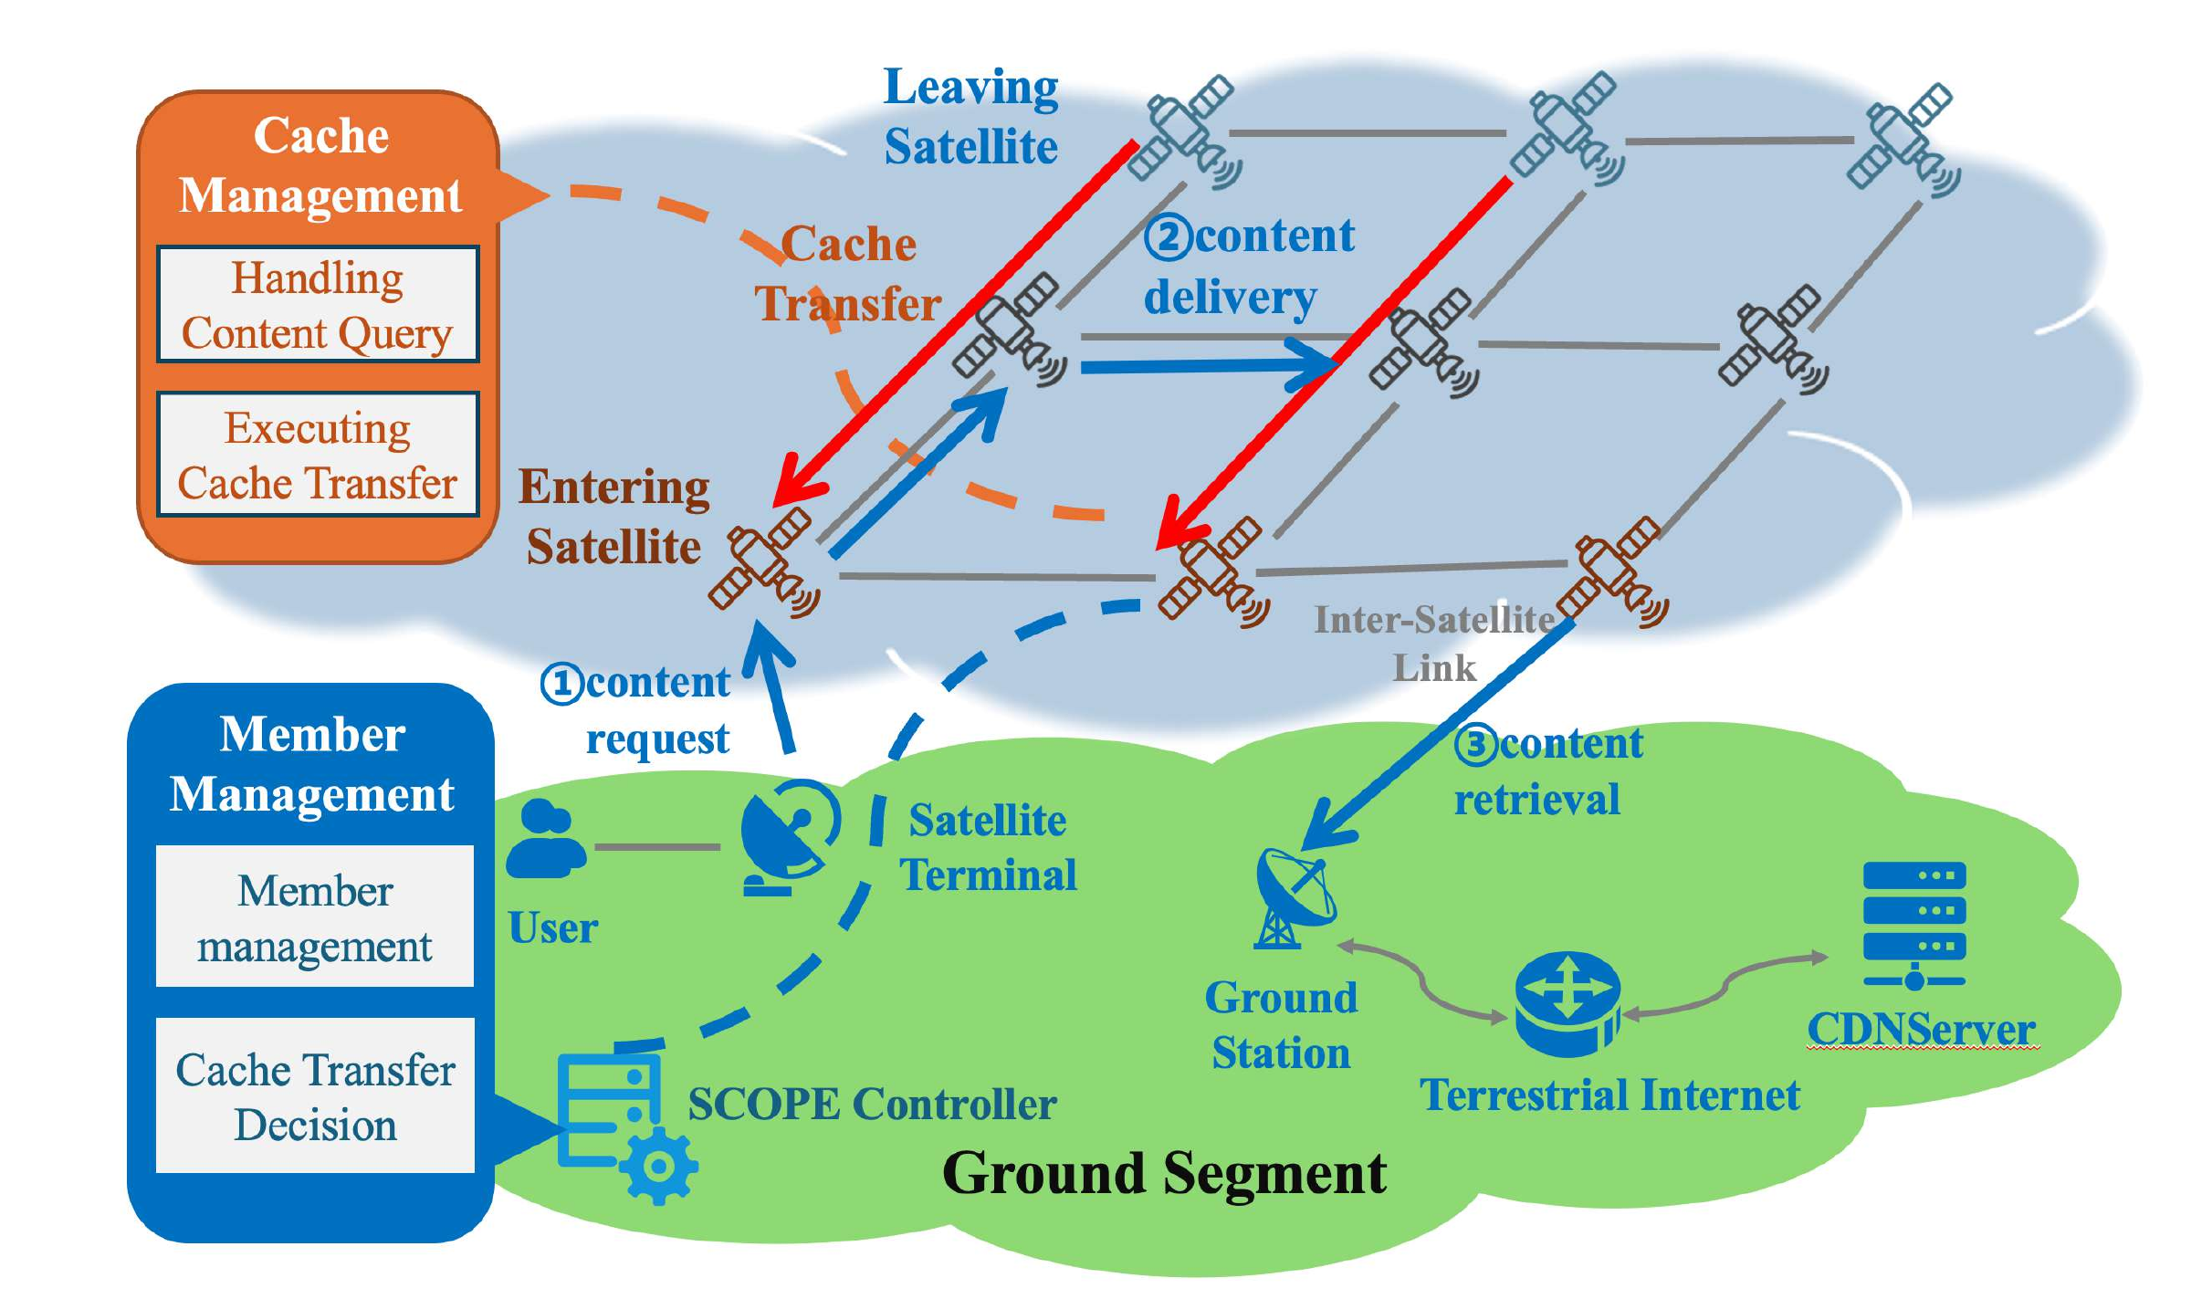
System Architecture
Tsinghua Univ.
Two control planes orchestrate the entire constellation cache
① Member Management
• Forms cache groups respecting
latency & coverage constraints
• Decides cache transfer between
leaving and entering satellites
② Cache Management
• Handles content queries inside
the satellite's local cache
• Executes value-aware cache
transfer during handover
③ Retrieval Workflow
1. Local cache hit
2. Cooperative inter-satellite hit
3. Fall-back via ground station
→ CDN through terrestrial Internet
Fig. 5: Overall architecture of SCOPE
Two coordination dimensions →
Spatial
Latency-constrained groups across nearby satellites
Temporal
Predictive migration during handover windows
Notes:
Figure 5 shows the SCOPE architecture. The ground segment runs the SCOPE controller, which has two logical modules: Member Management decides how satellites are grouped into cache cliques and which satellite should transfer cached content to whom; Cache Management runs on each satellite, handles local queries and executes the transfers. A user request follows a three-phase retrieval workflow: first the local cache, then a cooperative inter-satellite lookup, and finally a ground-station fallback to the origin CDN. This split lets the heavy planning live on the ground while satellites only execute lightweight decisions.

Slide 8
Spatial · Latency-Constrained Clique Search
Tsinghua Univ.
Step 1 — Find the largest groups whose pair-wise ISL latency ≤ τ
Problem
Intuition
Build an ISL graph G = (V, E) where
V = visible LEO satellites,
E = links with one-way delay ≤ τ ms.
We want every member of a cache group
to reach every other member within τ.
→ Equivalent to enumerating maximal
cliques in G.
Hardness: NP-hard in general,
but G is sparse and short-diameter,
so a Bron–Kerbosch-style search with
orbital pruning runs in seconds for a
Starlink-scale topology.
S1
S6
S2
S5
S3
S4
Highlighted triangle = a maximal clique (S1, S2, S3)
Take-away — SCOPE bounds intra-group latency by construction (≤ τ ms); Step 2 (next slide) partitions content uniformly across the clique.
Notes:
The first design decision is who can cooperate with whom. We model the visible constellation as an inter-satellite link graph and keep only edges whose one-way latency stays under a threshold tau. Any valid cache group must therefore be a clique in that graph, so that every member can reach every other member within tau milliseconds. Although clique enumeration is NP-hard in general, the ISL graph is sparse and short-diameter, so a Bron-Kerbosch search with orbital pruning finishes within seconds for Starlink-scale topologies. The right-hand schematic shows the idea: the orange triangle is one such latency-bounded clique.

Slide 9
Temporal · Predict, then Migrate
Tsinghua Univ.
Predict every leave/enter from orbital geometry · then migrate value-aware caches
Handover timeline
How it works
Inputs:
• Two-Line Element (TLE) ephemerides
• Region polygon Rᵢ for group i
For every satellite s, compute:
• t_enter(s, Rᵢ) — first contact
• t_leave(s, Rᵢ) — last contact
Schedule a migration job at
t_leave − Δ , Δ ≈ 30 s
(handover overlap window).
Costs almost nothing — orbital
geometry is deterministic, so the
controller pre-computes every event.
Leaving sat ────────────────► out of view
Entering sat ────► in view
t₀
t₁ pre-warn
t₂ overlap
t₃ leaves
predict & plan
migrate cache
• t₁ : controller predicts the upcoming leave / enter pair
• t₂ : 60-90 s overlap window — value-aware migration runs
• t₃ : leaving satellite drops out without service gap
Value-Aware Migration
Score = popularity × time-to-live × locality
Migrate only top-K objects through the ISL window
Skip stale or soon-expiring content → save ISL bandwidth
Predict, don't react · Migrate value, not just bytes
Notes:
Unlike terrestrial CDNs, LEO satellites move on deterministic orbits, so SCOPE turns handovers from a reactive event into a planned one. The controller projects each satellite footprint onto every group region using TLE ephemerides, obtaining an enter time and a leave time for every satellite-group pair. Before a leave event, while leaving and entering satellites still overlap, SCOPE schedules a migration job. The key is not to migrate arbitrary bytes: SCOPE scores cached objects by popularity, remaining time-to-live, and locality, then transfers only the top-K high-value objects and skips stale or soon-expiring content. In this way, the overlap window is used for value-aware migration rather than bandwidth-wasting replication.

Slide 10
Three-Phase Content Retrieval
Tsinghua Univ.
Local cache → Cooperative group lookup → Ground fallback
①
Local Cache
②
Cooperative Lookup
③
Ground Fallback
• Check on-board cache
• Hit ⇒ serve directly
(1-hop, ms-level RTT)
miss
• Query group members
via ISL (≤ τ ms)
• Hit ⇒ peer streams to user
• No ground round-trip
miss
• Forward request to ground
station ⇒ origin CDN
• Cache the response
for future hits
Where do hits land in our trace?
Phase ① Local
Phase ② Cooperative
Phase ③ Ground
62 %
23 %
15 %
Design Recap
Spatial —
latency-bounded cliques + uniform partitioning
Temporal —
orbit-predictive, value-aware migration
Workflow —
Local → Cooperative → Ground; latency-monotone
Notes:
Putting space and time together gives us the user-visible workflow. Every request walks through three phases. First, the satellite checks its own cache; a hit is served in a single hop. On a miss, phase two queries the rest of the cache group over inter-satellite links — still entirely in space, with latency bounded by tau. Only if both phases miss do we fall back to the ground station and origin CDN, and we cache that response for next time. In our traces, sixty-two percent of requests are answered locally and another twenty-three percent through cooperative lookup, leaving just fifteen percent for the ground link.

Slide 11
Part 3 / Performance Evaluation
03
Real Starlink trace · How well does SCOPE deliver?
▸ Robustness: cache-hit ratio under handover scale
▸ Continuity: latency stability over a 15-min trace
▸ Cost-Benefit: GSL traffic saved vs. ISL overhead
Notes:
We have presented the spatial and temporal coordination machinery of SCOPE. Now we ask the empirical question: how well does it actually work in flight? We evaluate three properties one by one. Robustness — does the cache-hit ratio hold up under different handover intensities? Service Continuity — can users perceive a smooth quality of experience over a real 15-minute Starlink trace, with no latency cliffs at handover boundaries? And finally Cost-Benefit — is the inter-satellite-link overhead we pay reasonable compared to the ground-satellite-link traffic we save? All experiments use a real Starlink constellation snapshot and three competitive baselines.

Slide 12
Experimental Setup
Tsinghua Univ.
Discrete-event Python simulator driven by real Starlink TLE data
Constellation
Network Model
Starlink Shell-1
550 km · 53° inclination
Real TLE-driven topology
ISL bandwidth bounded by
handover-window duration
(physical spectrum limit)
Workload
Content Model
Zipf request distribution
skewness α = 1.3
Heavy-head: 300–900 MB (videos)
Long-tail: 0.5–5 MB (web/text)
Single-copy storage policy
Realistic constellation × heterogeneous workload — a faithful LEO-CDN testbed
Compared baselines →
No-Handover
Static, ignores leave events
Size-based
Migrate by content size
Popularity-based
Migrate by access count
SCOPE (ours)
Spatio-temporal aware
12 / 18
Notes:
Now we move to the experimental setup. We built a discrete-event simulator in Python, driven by real-world TLE data of the Starlink Shell-1 constellation at 550-kilometer altitude and 53-degree inclination. The ISL bandwidth between satellites is bounded by the handover-window duration, reflecting the real physical-layer time and spectrum constraints. The workload follows a Zipf distribution with skewness 1.3, and the content model includes both heavy-head video objects and long-tail web or text objects. Inside each collaboration group, we use a single-copy storage policy, so every handover can remove unique cached data and stress the migration algorithm. We compare four strategies: No-Handover as the static baseline, Size-based migration, Popularity-based migration, and SCOPE, our spatio-temporal aware approach.

Slide 13
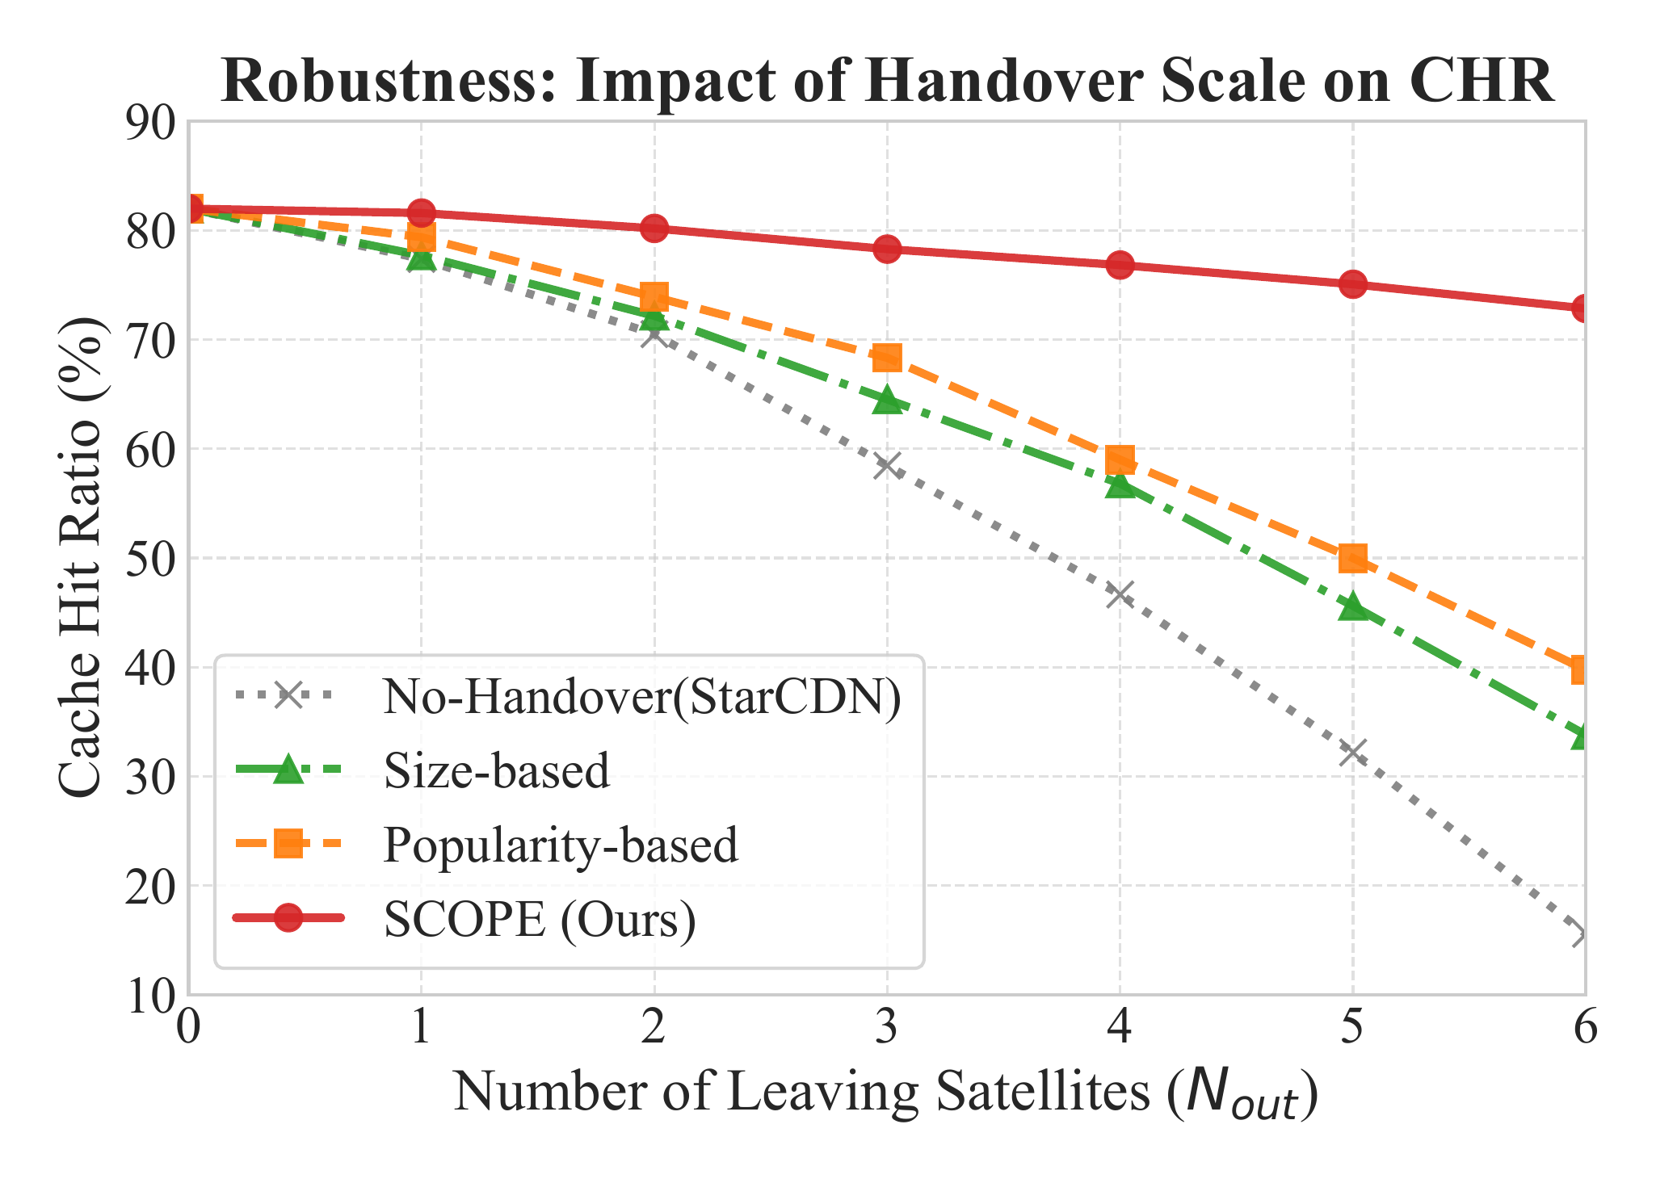
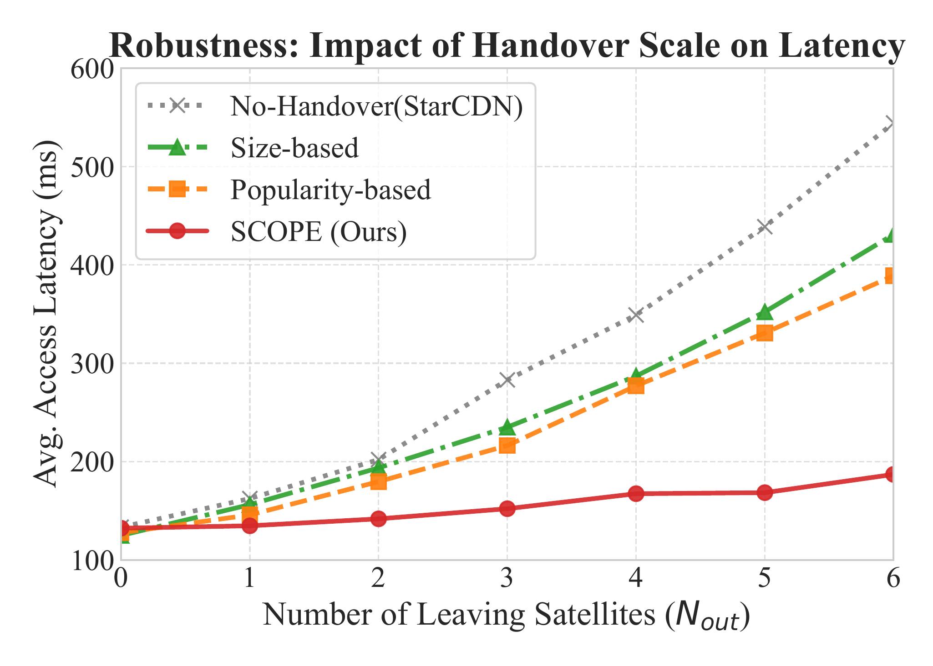
Robustness · Handover Scale
Tsinghua Univ.
Vary the number of leaving satellites Nout from 0 to 6
Fig. 6: Cache hit ratio vs. Nout
Fig. 7: Avg. access latency vs. Nout
SCOPE stays nearly flat as topology churns
• At Nout=6, SCOPE keeps CHR ≈ 73 % (vs. 33 % Size, 40 % Popularity, 16 % No-Handover)
• Latency stays ≈ 190 ms while baselines spike to 380–540 ms
13 / 18
Notes:
We start with a robustness stress test. We vary N_out, the number of satellites leaving the group simultaneously, from zero to six.
Figure 6 on the left shows the cache hit ratio. As more satellites leave, all strategies degrade, because the lost unique data grows linearly with N_out and quickly saturates the ISL bandwidth.
But SCOPE stays remarkably flat: at N_out equals six, SCOPE still keeps the hit ratio around 73 percent, while Popularity-based drops to 40 percent, Size-based to 33 percent, and No-Handover collapses to 16 percent.
Figure 7 on the right tells the same story for latency. SCOPE's latency stays around 190 milliseconds even at the worst churn level, while the baselines balloon to between 380 and 540 milliseconds.
Why? Size-based fills the bandwidth with unpopular junk files; Popularity-based exhausts bandwidth after migrating just a few large videos. SCOPE picks high-value, bandwidth-efficient items and therefore preserves performance.

Slide 14
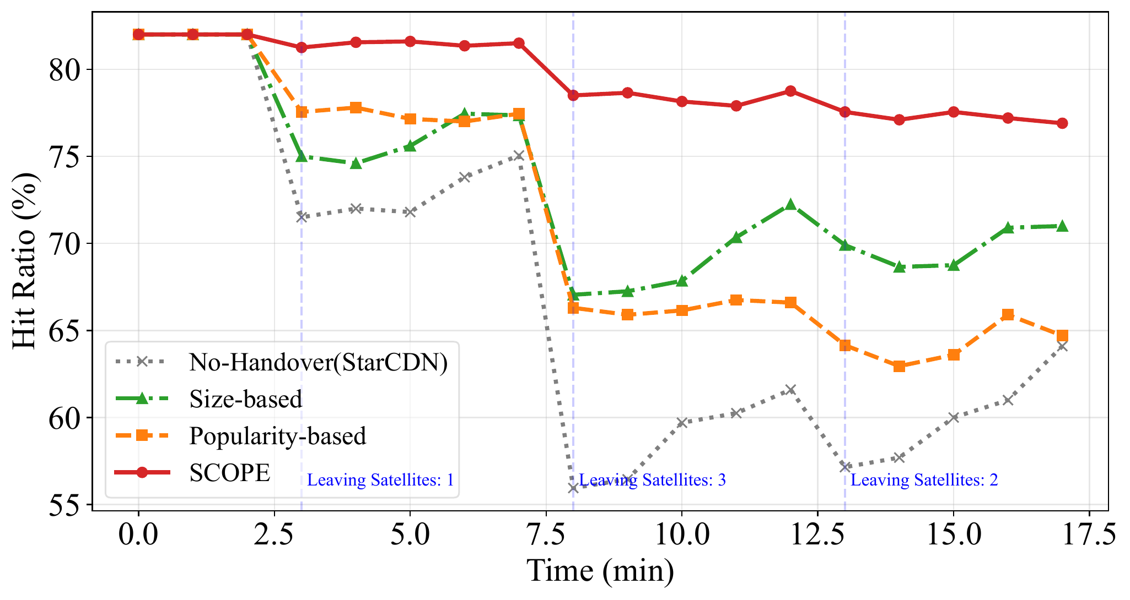
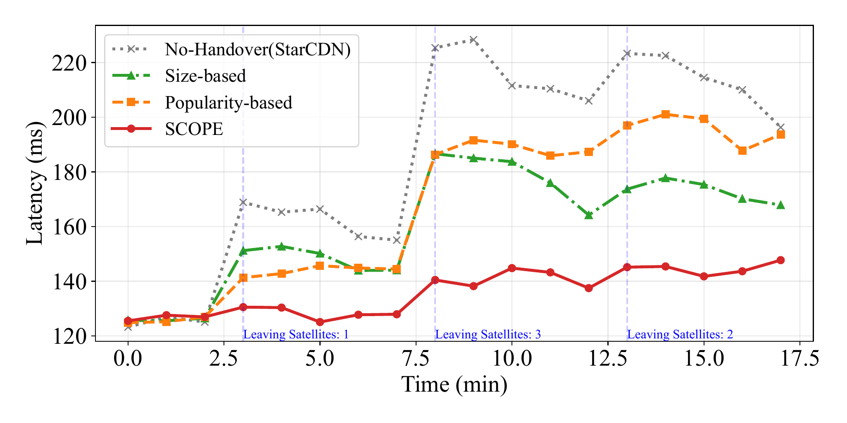
Service Continuity · 15-min Trace
Tsinghua Univ.
US region · handover events at t = 3, 8, 13 min (1 / 3 / 2 sats leave)
Fig. 8: Real-time cache hit ratio
Fig. 9: Real-time service latency
No cliffs at handover boundaries — entering satellites already serve a warm cache
• Baselines drop CHR by 10–18 % and latency surges past 220 ms after each event
• SCOPE holds CHR > 77 % and latency ~ 140 ms throughout the 15-min trace
14 / 18
Notes:
Next we look at service continuity through a 15-minute time-series trace in the US region. There are three handover events at minute 3, minute 8, and minute 13, with one, three, and two satellites leaving respectively.
Figure 8 shows the real-time cache hit ratio. The baselines all show clear cliffs at each event: hit ratio drops by 10 to 18 percentage points and recovers only slowly through the cache warm-up. The No-Handover line is the worst — it crashes below 60 percent.
Figure 9 shows the real-time latency, mirroring the same pattern: baselines spike past 220 milliseconds.
SCOPE, in contrast, remains nearly steady across the entire trace. The hit ratio stays above 77 percent and the latency hovers around 140 milliseconds. This is because SCOPE proactively migrates high-value-density content via ISLs before the physical handover, so entering satellites already serve users with a warm cache the moment they take over.

Slide 15
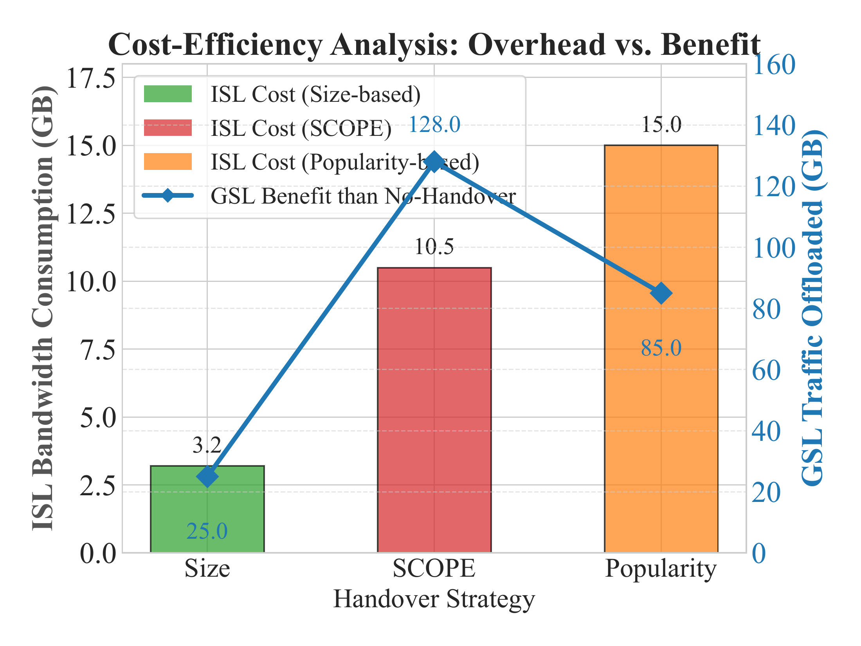
Cost-Benefit Analysis
Tsinghua Univ.
ISL overhead (cost) vs. GSL traffic offloaded (benefit)
Size-based
Cost: 3.2 GB
Benefit only 25 GB →
lowest ISL but no real GSL relief.
SCOPE (Ours)
Cost: 10.5 GB
Benefit 128 GB → highest offload
with only moderate ISL use.
Popularity-based
Cost: 15.0 GB
Spends most ISL on big videos,
yet offloads only 85 GB.
Fig. 10: Bars = ISL overhead · Line = GSL offloading
Evaluation Recap →
Robustness
Cache-hit ratio > 77% across handover scales
Continuity
End-to-end latency stable at ~140 ms (no cliff)
Cost-Benefit
GSL traffic ↓ > 50%; ISL overhead only 10.5 GB
15 / 18
Notes:
Now the cost-benefit analysis. We measure ISL bandwidth consumption as the cost, and GSL traffic offloaded compared to No-Handover as the benefit.
Look at Figure 10. Size-based has the lowest cost — only 3.2 gigabytes of ISL — but it also produces almost no real benefit, just 25 gigabytes of GSL offloading.
Popularity-based has the highest ISL cost at 15 gigabytes, because it tries to migrate large video files, yet its benefit is only 85 gigabytes, lower than SCOPE.
SCOPE sits at the sweet spot: with 10.5 gigabytes of ISL bandwidth — moderate cost — it offloads 128 gigabytes of GSL traffic, which is the highest benefit by a clear margin.
This validates that the value-density-based selection truly maximizes the utility of every byte transferred over the satellite constellation.

Slide 16
Part 4 / Conclusion
04
Recap, related work, and future directions
▸ SCOPE turns isolated caches into a coherent CDN fabric
▸ Bridges the gap of LEO-aware proactive collaboration
▸ Energy-efficiency · Inter-constellation · Resilience
Notes:
We have shown that SCOPE delivers strong empirical wins across robustness, continuity, and cost-benefit. In this final part, let me consolidate the story. First, I will recap the conclusion: what exactly the satellite-CDN community should take away from this work. Second, I will briefly position SCOPE against related literature — most prior LEO-cache work is either per-satellite or replication-only, and does not exploit predictable orbital geometry. Third, I will outline three future directions we believe are worth pursuing: energy-aware migration with limited solar budgets, inter-constellation cooperation across providers, and resilience under partial inter-satellite-link failures or DDoS conditions.

Slide 17
Conclusion
Tsinghua Univ.
SCOPE — turning isolated satellite caches into a coherent CDN fabric
The Problem
Our Approach: SCOPE
High orbital mobility + limited onboard storage
→ Cache-island effect & cold-start at every handover
Spatial: latency-constrained collaboration groups
Temporal: proactive value-density-based migration
Cache-Hit Ratio
Service Latency
GSL Traffic Saved
> 77 %
~ 140 ms
> 50 %
steady at handovers
no cliffs across 15 min
128 GB / 10.5 GB ISL
Key Takeaways
Related Work & Future Directions
• Pool isolated satellite storage via latency-cliques
• Migrate value, not bytes — predict with orbits
• Three-phase retrieval keeps misses local & cheap
• Validated on real Starlink trace, all metrics ↑
• Existing LEO caching: per-satellite or replication-only
• Energy-aware migration with limited solar budget
• Inter-constellation cooperation (Starlink × Kuiper)
• Resilience under partial ISL failure & DDoS
17 / 18
Notes:
Let me wrap up. The problem we tackled is the cache island challenge in LEO satellite CDNs, caused by two intrinsic facts: high orbital mobility and very limited onboard storage. Together they produce a cold-start cliff at every service handover — entering satellites land with empty caches and users feel the pain.
Our solution, SCOPE, jointly optimizes cache management along two dimensions. Spatially, it pools isolated storage resources via latency-constrained grouping so that nearby satellites act as one logical cache. Temporally, it maintains service continuity through proactive content migration, driven by the value-density metric, during the predictable handover windows.
Driven by real Starlink TLE traces, SCOPE delivers three results that matter to operators: a cache hit ratio above 77 percent that holds steady through handovers, a latency around 140 milliseconds with no cliffs at the event boundaries, and over 50 percent of ground-satellite-link traffic offloaded — about 128 GB of GSL relief for only 10.5 GB of ISL spend.
In short, SCOPE turns the isolated, drifting satellite caches into one coherent CDN fabric.

Slide 18
Thank You
Questions & Discussion
SCOPE: Spatio-Temporal Collaborative Caching
and Proactive Transfer in LEO Satellite Networks
APNet 2026 · Tsinghua University
Contact: liuyy123 @ mails.tsinghua.edu.cn
Notes:
That brings me to the end of the talk. Thank you very much for your attention, and I am very happy to take any questions.
To recap in one sentence: SCOPE is a spatial-temporal cache collaboration framework that keeps LEO satellite CDNs continuous and efficient — more hits, lower and smoother latency, and significantly less ground-satellite traffic.
I will be glad to discuss any aspect: the value-density metric, the grouping policy, the simulator setup, or the future directions. Thank you.

